Slide 1
CROP PROTECTION FROM ANIMALS –DEEP LEARNING
By,
Soujanya S ECE-D
Sripriya S ECE-D
Gowsalya P ECE-A
Deivanai N ECE-A
IV Year
Sona College of Technology

Slide 2
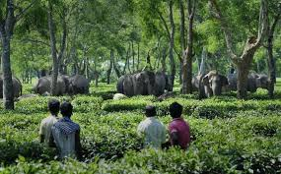
LET’S ATTACK THE FIELDS!!!!!!

Slide 3
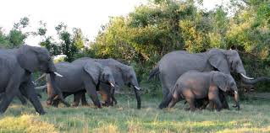
OBJECTIVE
To detect animals entering into the field and them away making a sound using Deep Learning concept.

Slide 4

JUPYTER NOTEBOOK
The Jupyter Notebook is an open-source web application that allows you to create and share documents that contain live code, equations, visualizations and narrative text.

Slide 5
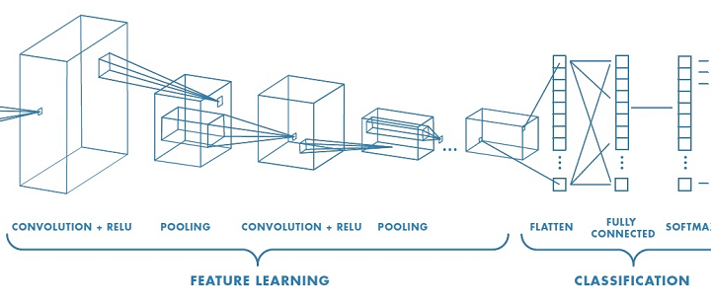
PROCESS INVOLVED IN CNN
Convolution
Max Pooling
Flattening
Full-Connection

Slide 6
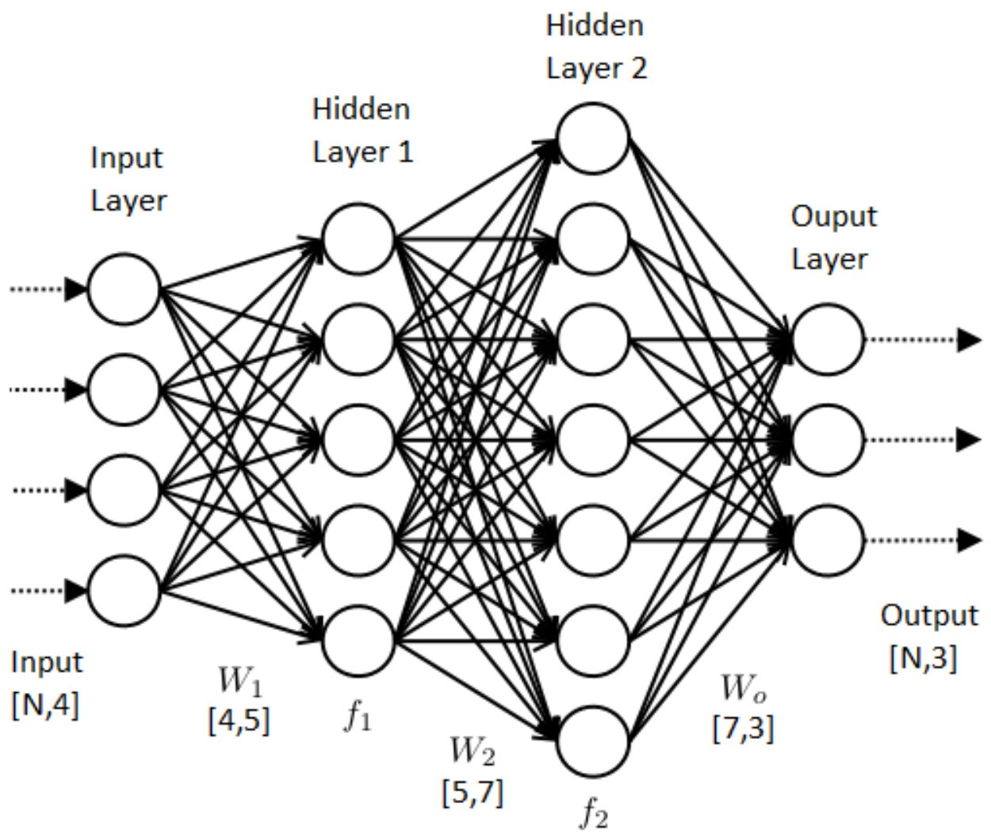
PROCESS INVOLVED IN ANN
Input Layer
Hidden Layer
Output Layer

Slide 7
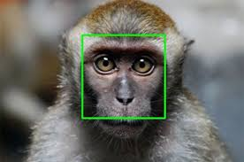
DETECTION OF ANIMALS
The live video captured is splitted into frames and it is compared with the training dataset, to detect the entry of the animal.
Once the animal is detected, a sound is produced to drive away the animal

Slide 8
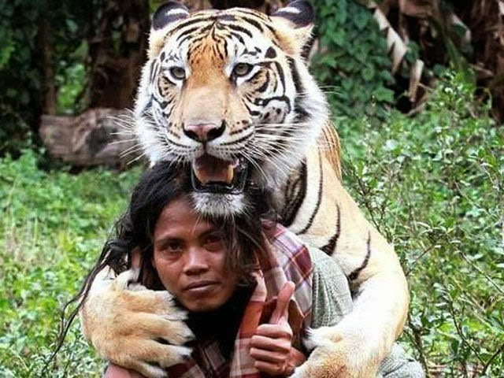
RESULT Thus, we developed the model to detect animals and to produce a sound to drive them away. By this manner, we achieve the ultimate aim of establishing a good human-wildlife relationship by not affecting both.

Slide 9
Thank You!!!

